Slide 1
Normalization

Slide 2
Database Design Strategies
Two classical approaches to database design:
▪
–
Top-down design - CONCEPTUAL MODELLING
•
•
•
Identifies data sets (entities)
Defines data elements (items) for each of those sets
Involves the identification of different entity types
definition of each entity's attributes
and the
–
Bottom-up design - NORMALISATION
•
•
•
Identifies data elements (items)
Groups them together in data sets (entities)
First defines the attributes and then groups them entities
to form

Slide 3
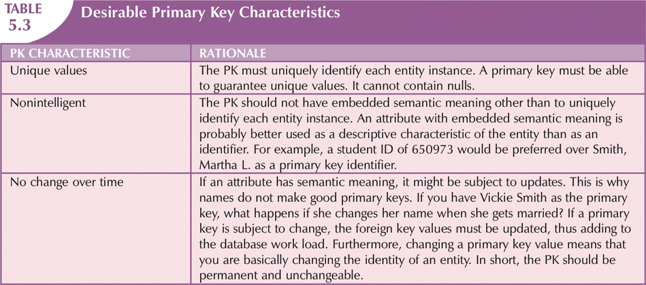
A
look
back
at
Primary
Keys

Slide 4
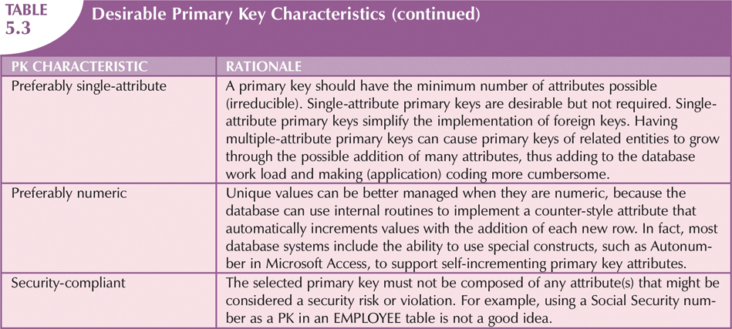
A
look
back
at
Primary
Keys
continued

Slide 5
Normalisation
Normalisation is a technique for producing a set of relations with desirable properties, given the data requirements of an enterprise:
▪
–
–
Developed by E.F. Codd (1972)
Often performed as a series of tests on a relation to
determine
whether it satisfies or violates the requirements
form
of
a
given
normal
▪
Four
–
–
–
–
then
–
most commonly used normal
First (1NF),
Second (2NF),
Third (3NF),
Boyce-Codd (BCNF)
forms are:
▪
4NF, 5NF, …, etc. (required
applications)
by some fairly
specialised

Slide 6
Normalisation
Based on concept of functional dependencies among the attributes of a
relation
Major aim of relational database design is to group attributes into relations
(represented by entities on the ERD) to
- minimise data redundancy, and
- reduce file storage space required by base relations
Although normalisation can be used in small systems for bottom up design, our use will be to validate entities on an ER and gather extra ER model information (entities and attributes) from business forms
Example: company that manages building projects
▪
▪
▪
▪
-
-
-
Charges its clients by billing hours spent on each contract
Hourly billing rate is dependent on employee's position
Periodically, report is generated that contains information such as displayed in Table 6.1 (Coronel, Morris and Rob [C, M & R])

Slide 7
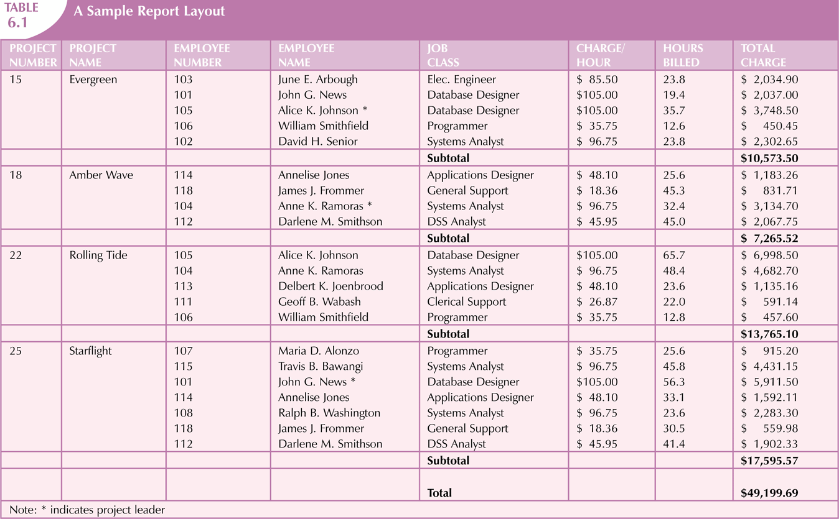
Why
Normalisation
is
required
(cont'd)

Slide 8
Problems with table in Figure 6.1
PROJ_NUM intended to be primary key, but it contains nulls
JOB_CLASS invites entry errors - e.g., Elec. Eng. vs Elect. Engineer vs E.E. Table has redundant data
▪
▪
▪
-
-
details of a charge per hour are repeated for every occurrence of job class
Every time an employee is assigned to a project emp name repeated
▪
Relations that contain redundant information may potentially suffer from several
update anomalies
-
Types of update anomalies include:
•
Insert Anomaly
- Insert a new employee only if they are assigned to a project
Delete Anomaly
- Delete the last employee assigned to a project?
- Delete the last employee of a particular job class?
Modification (or update) Anomaly
- Update a job class hourly rate - need to update multiple rows
•
•

Slide 9
The Normalisation Process Goals
Each table represents a single subject
No data item will be stored in more than one table
- Except to connect tables
All attributes in a table are dependent on the primary Each table is void of insert, update, delete anomalies Ensure that all tables are in at least 3NF
▪
▪
▪
▪
▪
key
- Higher forms are less commonly encountered
business environment
in a

Slide 10
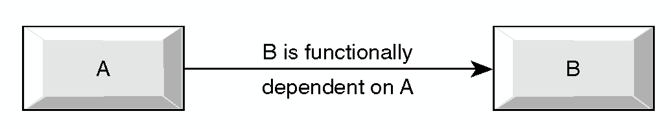
Functional Dependence
▪
An attribute B is FUNCTIONALLY DEPENDENT on another attribute A, if a
value
-
-
-
-
of A determines a single value of B at any one time.
A ➔ B
EMP# ➔ EMP_NAME
CUSTNUMB ➔ CUSTNAME
ORDER-NUMBER ➔ ORDER-DATE
•
ORDER-NUMBER - independent variable,
the DETERMINANT
ORDER-DATE - dependant variable
also know as
•
▪
TOTAL DEPENDENCY
-
attribute A determines B AND attribute B determines A
•
EMPLOYEE-NUMBER ⬅➔ TAX-FILE-NUMBER

Slide 11
Full Dependency
FULL DEPENDENCY
▪
-
An attribute Y is considered to have a full dependency on a SET
of ATTRIBUTES X when:
• Y is functionally dependent on SET X
• Y is not functionally dependent on a proper SUBSET of X.
▪
Example:
-
ORDER-NUMBER, PART-NUMBER ➔ QTY-ORDERED
•
•
X={ORDER-NUMBER, PART-NUMBER}
Y ={QTY-ORDERED}.
-
QTY-ORDERED is fully dependent on ORDER-NUMBER, PART-
NUMBER.
•
QTY-ORDERED cannot be determined by knowing only ORDER-
NUMBER or PART-NUMBER. It can only be determined by knowing
both ORDER-NUMBER and PART-NUMBER.

Slide 12
Partial Dependency
An attribute Y is considered to have a partial dependency
Y is functionally dependent on a proper subset of X.
Example:
▪
on
X when
▪
▪
ORDER-NUMBER, PART-NUMBER
➔ QTY-ORDERED, PART-DESCRIPTION
X={ORDER-NUMBER,PART-NUMBER}
Y={PART-DESCRIPTION}
▪ part-description is said to be partially dependent
▪
▪
on
order-
number and part-number because part-description can be
determined by only part-number.
▪ Part-description is determined by a subset of X, {PART- NUMBER}
How about QTY-ORDERED? Fully or partial dependent?
▪

Slide 13
TRANSITIVE DEPENDENCY
Transitive dependency occurs when
▪
-
Y depends on X, and Z depends on Y - thus Z also depends
i.e., X ➔ Y ➔ Z
and Y is not a candidate key (or part of a candidate key)
on
X
-
▪
▪
Indirect dependency.
INVOICE-NUMB ➔ SALE_AMOUNT, CUSTOMER-NUMB ➔
CUSTOMER-NAME
-
INVOICE-NUMB determines CUSTOMER-NUMB, which in turn
determines CUSTOMER-NAME.
CUSTOMER-NUMB is not a candidate key and determines CUSTOMER-
NAME.
There is a transitive dependency of CUSTOMER-NAME on CUSTOMER-
NUMB.
-
-

Slide 14
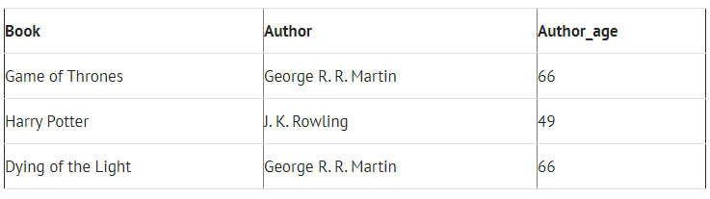
TRANSITIVE DEPENDENCY
Book → Author (if we know the book, we also know the author)
Author is not a part of the candidate key
Author → Author_age (if we know the author, we also know his/her age)
Author_age has transitive dependency on Book

Slide 15
DEPENDENCY
Full
-
SUMMARY
▪
▪
Functional
A
B
C
D
E
A
B
▪
Partial
▪
Total
A
B
C
D
E
A
B
▪
Transitive
A
B
C
D
E

Slide 16
First Normal Form
Unnormalised form (UNF) - raw data from table/form/grid
UNF: PROJECT (proj_num, proj_name (emp_num, emp_name, ….))
▪
▪
-
View Figure 6.1 as a set of projects with each project having
set of project-employee details (Representation 1)
a
▪
FIRST NORMAL FORM (part of formal definition of relation)
-
A TABLE IS IN FIRST NORMAL FORM (1NF) IF -
•
•
•
it is a valid table (in particular no repeating groups)
a unique key has been identified for each row
all attributes are functionally dependent on all or part the key
of
-
-
1NF: PROJECT (proj_num, proj_name)
1NF: ASSIGN (proj_num, emp_num, emp_name, job_class, chg_hour, assign_hours)

Slide 17
UNF to 1NF transformation
Identify the repeating group(s), if any, in the unnormalised relation
Move from UNF to 1NF by removing repeating group along with the PK of the
main relation
Important property of normalisation decomposition
▪
▪
▪
-
Lossless-join property enables us to find any instance of the original relation
from corresponding instances in the smaller relations
hence must extract PK of main relation
-
▪
Determine PK of new relations created
-
extracted repeating group will normally have a composite PK including the
main relations PK
•
but NOT always, PK of main relation may simply act as a FK
- INSURED (comp_code, comp_name (insured_id,
insured_name, ...))
» COMPANY (comp_code, comp_name)
» INSURED (insured_id, comp_code, insured_name, ...)

Slide 18
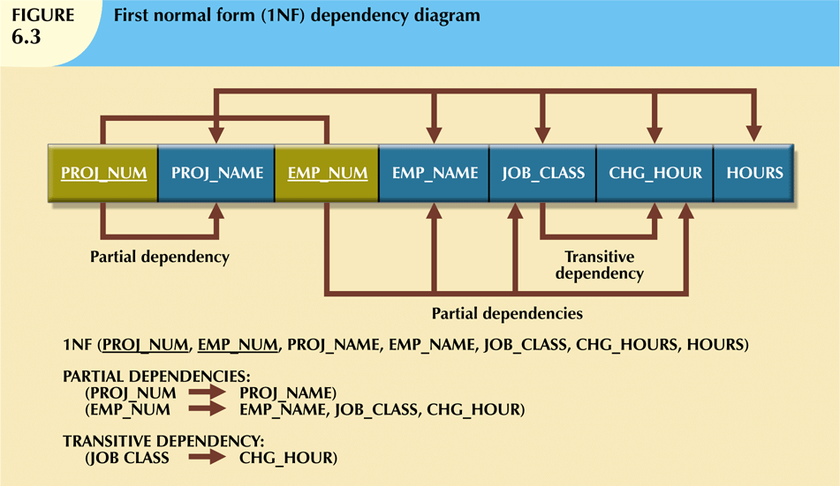
Dependency
Diagram
(1NF)

Slide 19
1NF
Each time another employee is assigned to a project, some data entries (such as PROJ_NAME, EMP_NAME, and CHG_HOUR) are unnecessarily repeated.
Anomaly!!
-Redundancy due to Partial and Transitive Dependency

Slide 20
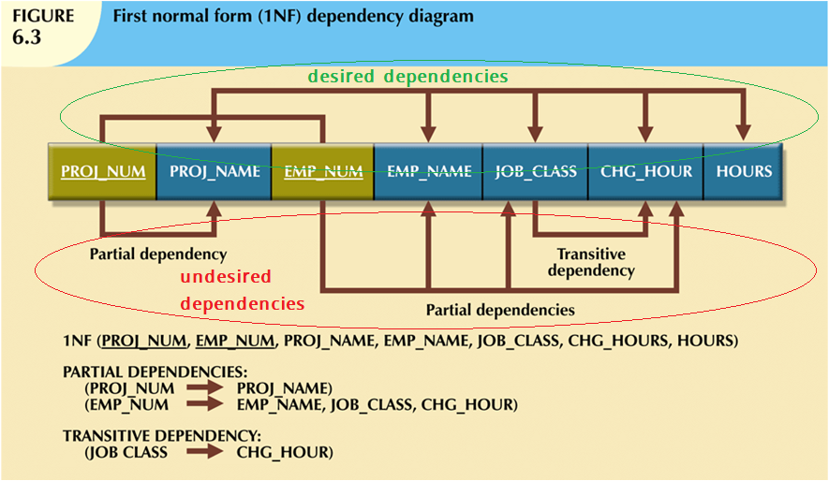
Dependency
Diagram
(1NF)

Slide 21
1NF to 2NF
A RELATION IS IN 2NF IF -
▪
-
all non key attributes are functionally dependent on the entire key
•
ie. no partial dependencies exist
▪
▪
Representation 1:
Move from 1NF to 2NF by removing partial dependencies
-
-
1NF: PROJECT (proj_num, proj_name)
1NF: ASSIGN (proj_num, emp_num, emp_name, job_class, chg_hour, assign_hours)
▪
1NF: PROJECT (proj_num, proj_name)
-
already in 2NF only one attribute in PK thus CANNOT be any partial
dependencies
•
2NF: PROJECT (proj_num, proj_name)
▪
1NF: ASSIGN (proj_num, emp_num, emp_name, job_class, chg_hour,
assign_hours)
-
becomes
•
•
2NF EMPLOYEE (emp_num, emp_name, job_class, chg_hour)
2NF ASSIGN (proj_num, emp_num, assign_hours)

Slide 22
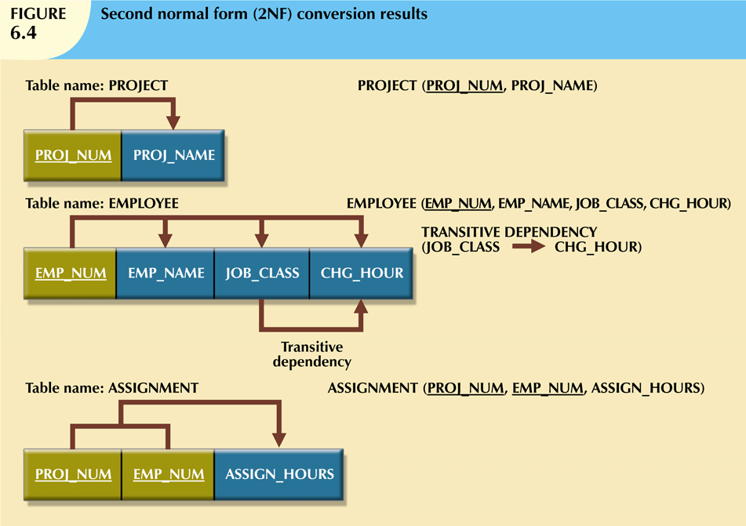
2NF
Conversion
Results

Slide 23
2NF
If the charge per hour changes for a job classification held by many employees, that change must be made for each of those employees. If you forget to update some of the employee records that are affected by the charge per hour change, different employees with the same job description will generate different hourly charges.
Anomaly!!
-Redundancy due to Transitive Dependency

Slide 24
2NF to 3NF
A RELATION IS IN 3NF IF IT IS 2NF AND -
▪
-
all transitive dependencies have been removed - check for non-
key attribute dependent on another non-key attribute
from 2NF to 3NF by removing transitive dependencies
2NF: PROJECT (proj_num, proj_name)
▪
Move
-
-
-
2NF EMPLOYEE (emp_num, emp_name, job_class,
2NF ASSIGN (proj_num, emp_num, assign_hours)
chg_hour)
▪
PROJECT and ASSIGN already in 3NF
-
-
3NF: PROJECT (proj_num, proj_name)
3NF ASSIGN (proj_num, emp_num, assign_hours)
▪
2NF EMPLOYEE (emp_num, emp_name, job_class, chg_hour)
-
-
3NF EMPLOYEE (emp_num, emp_name, job_class)
3NF JOB (job_class, chg_hour)

Slide 25
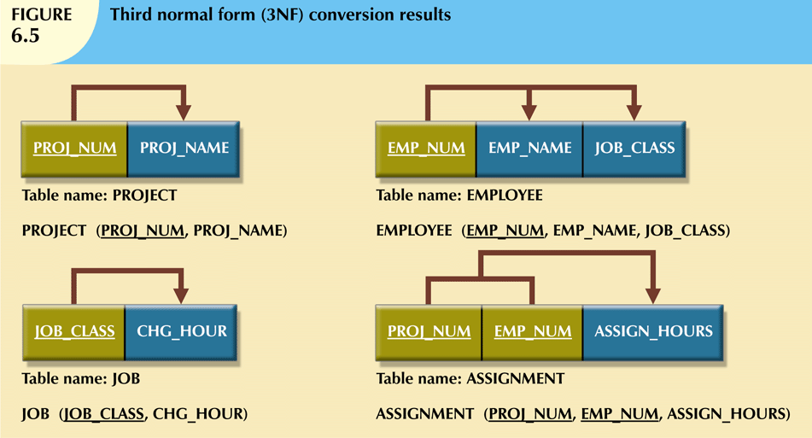
3NF
Conversion
Results

Slide 26
Entire Process UNF to 3NF
UNF
▪
-
PROJECT (proj_num, proj_name, emp_num (emp_num, emp_name,
job_code, job_description, job_chg_hour, assign_hours))
remove repeating groups and identify PK
PROJECT (proj_num, proj_name, emp_num)
ASSIGN (proj_num, emp_num, emp_name, job_code, job_description, job_chg_hour, assign_hours)
remove partial dependencies
PROJECT (proj_num, proj_name, emp_num)
EMPLOYEE (emp_num, emp_name, job_code, job_description, job_chg_hour)
ASSIGN (proj_num, emp_num, assign_hours)
remove transitive dependencies
PROJECT (proj_num, proj_name, emp_num)
EMPLOYEE (emp_num, emp_name, job_code)
ASSIGN (proj_num, emp_num, assign_hours)
JOB (job_code, job_description, job_chg_hour)
▪
1NF
-
-
–
▪
2NF
-
-
-
3NF
-
-
-
-
–
▪
–
▪
Note: R&C show some further 'suggested' improvements

